Slide 2
Learning objectives
Understand massive scale data management and processing with Hadoop
Understand and able to use Hadoop components for big data platform designs
Able to integrate Hadoop with other frameworks for data ingestion and analytics systems
Notes:
https://www.youtube.com/watch?v=aReuLtY0YMI
https://www.youtube.com/watch?v=JWX5Inb--ig

Slide 3
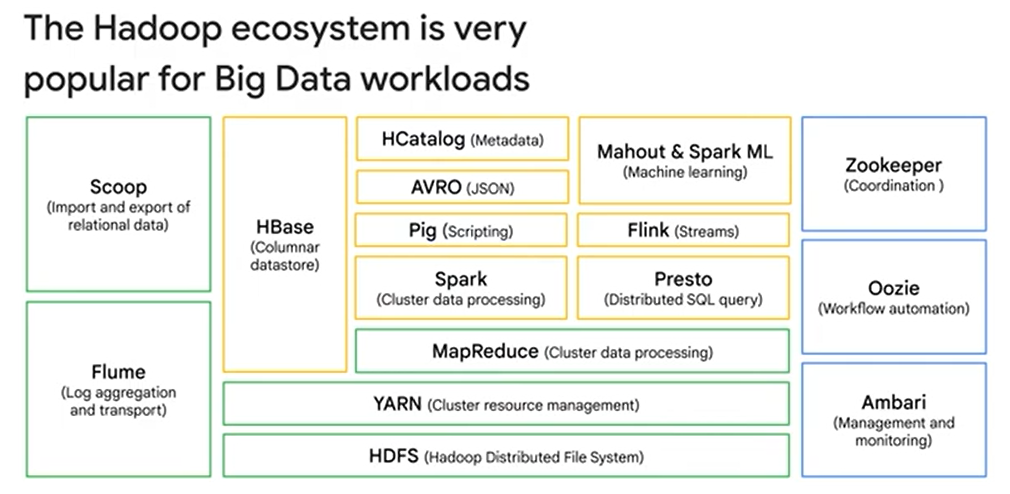



Slide 4

●
●
●
●

Slide 5

●
●
●
●

Slide 6





Slide 7
Hadoop
http://hadoop.apache.org/, original from Yahoo
The goal is to combine storage and processing in the same cluster system
Designed for massive scale of data and computing with shared nothing architecture
commodity hardware, highly scalability, fault tolerance, easy to extend
Suitable for both on-premise and clouds
There are very rich software ecosystems centered
around Hadoop

Slide 8



Slide 9
Hadoop: layers
Com mon
MapReduce |  | others
YARN
Hadoop File System (HDFS)
others
Cluster
(of shared nothing nodes)

Slide 10
Hadoop key components
HDFS as a distributed file system
for managing data
YARN as a resource management system
for executing and managing analytics tasks
MapReduce as one programming model
for MapReduce applications
Coordination (ZooKeeper)
for fault tolerance and metadata

Slide 11
●
●
●
●

Slide 13
Hadoop File System (HDFS)
For handling very big data files
GBs of data within a single file
Assumption of data handling
write-once-read-many
not suitable for random-access update → analytics data
Deal with hardware failures, support data locality, reliability
“high fault tolerance” with “low-cost/commodity hardware”

Slide 14

https://hadoop.apache.org/docs/r1.2.1/hdfs_design.html

Slide 15
Datanodes
NAME NODE
1
4
5
3
6
1
2
8
3
7
8
5
7

Slide 16
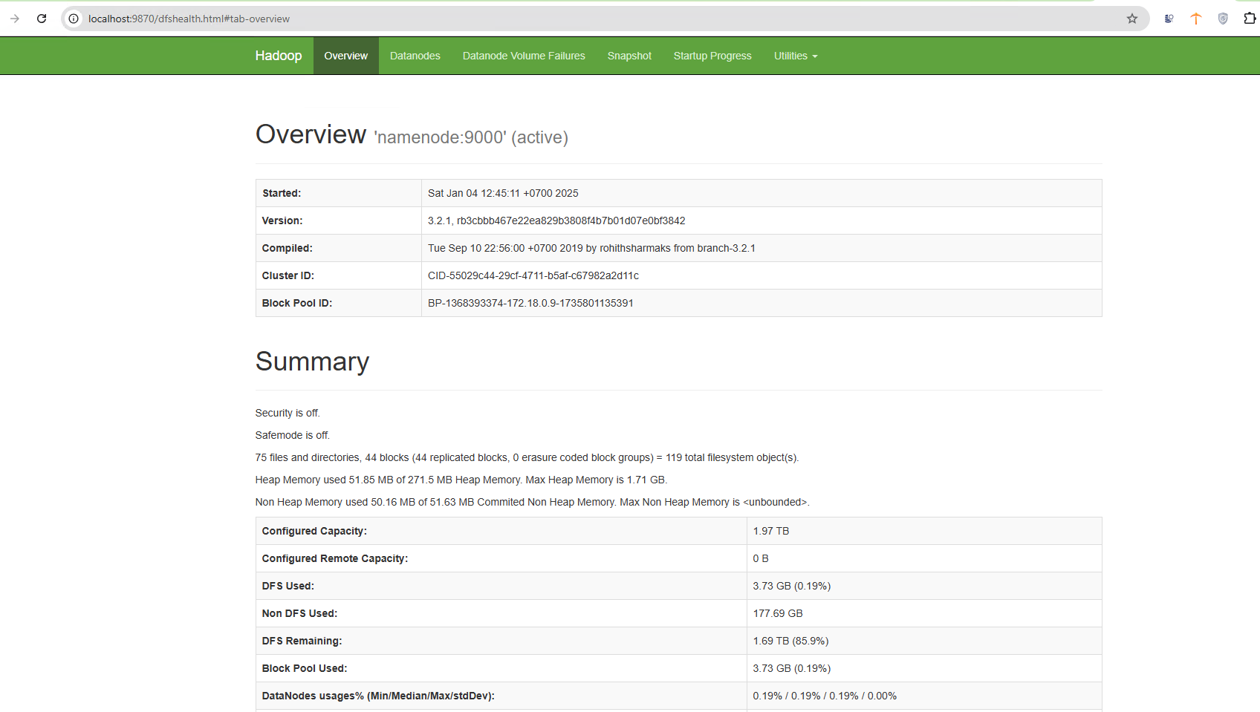

Slide 17
Datanodes
1
4
5
3
6
1
2
8
3
7
8
5
7

Slide 18
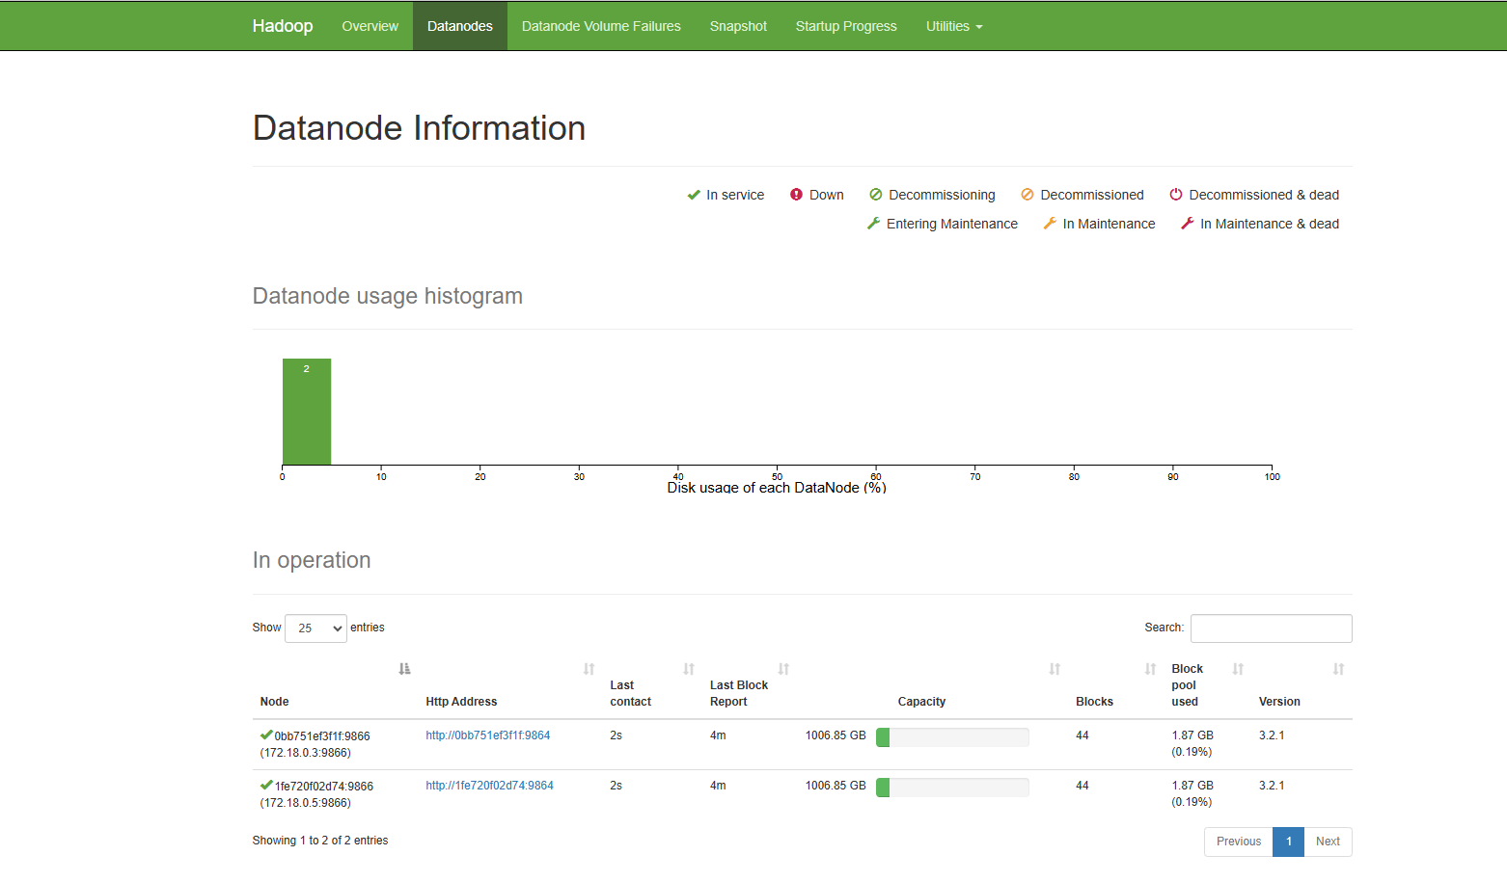

Slide 19
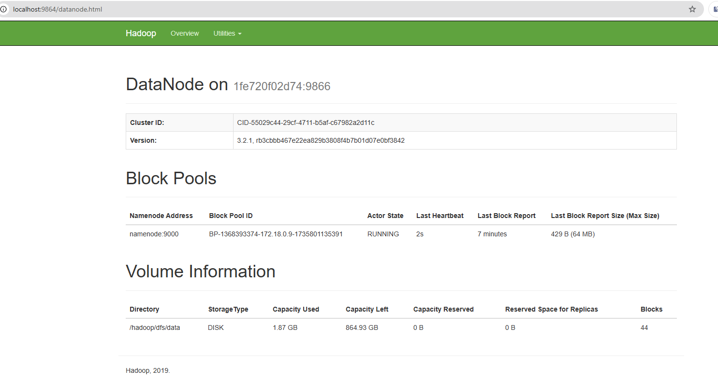

Slide 20
Datanodes
1
4
6
1
2
3
8
3
7
8
5
7
5

Slide 21
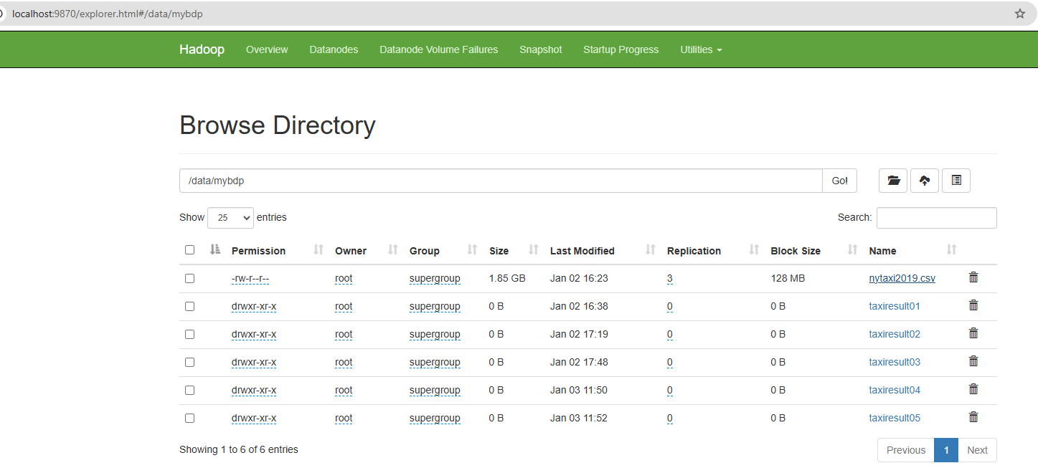

Slide 22
Datanodes
1
4
6
1
2
3
8
3
7
8
5
7
5
1
3
New datanode is created by the namenode

Slide 23
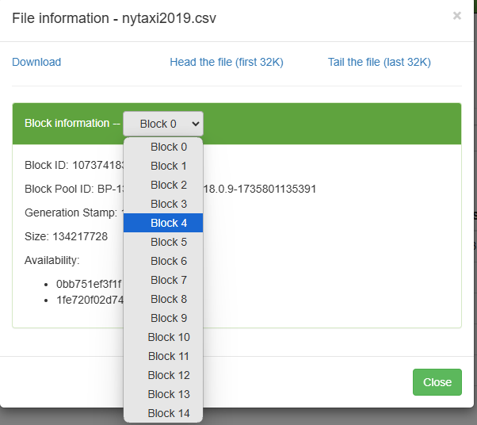

Slide 24
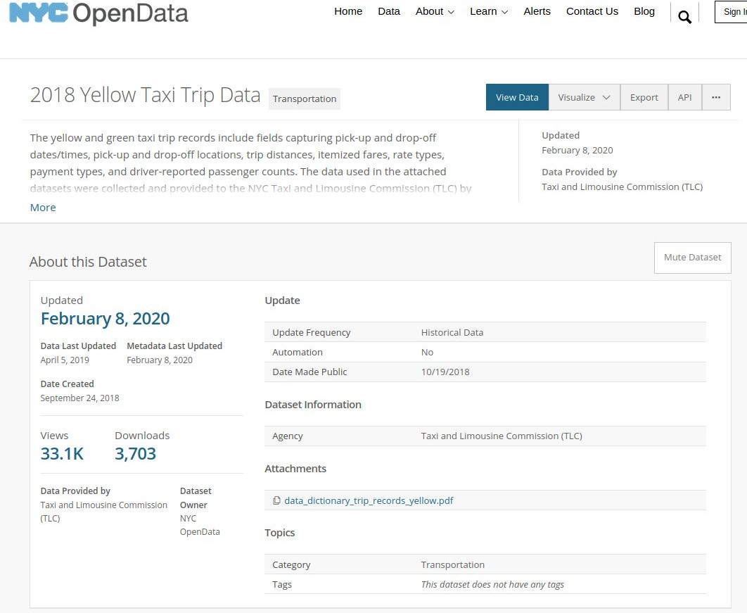
Example
e.g., 112M rows
Snapshot from: https://data.cityofnewyork.us/Transportation/2018-Yellow-Taxi-Trip-Data/t29m-gskq

Slide 25
HDFS - data blocks
Files are stored in many nodes
but the application accesses HDFS files just like “typical file systems”
A file includes many blocks
File blocks are replicated and distributed across nodes
Conventional way of access data
naming resolving: hdfs://
common operations: list, put, get, …

Slide 26
File blocks, metadata and data replication
Block size is 128MB (default)
can be configurable but should not be small size
all blocks of the same file are the same, except the last one
Data is replicated across the cluster
usually, replication factor is 3
NameNode manages file system metadata

Slide 27
HDFS fault tolerance
Data blocks
file blocks are replicated and distributed across nodes
Rack awareness
avoid communication problems between nodes in different racks
Monitoring
DataNode reports to NameNode
Read and write
using NameNode for metadata and for information of DataNodes
NameNode has replication (master-worker)

Slide 28
Compatible file systems with HDFS
Many file systems are compatible with HDFS
for integration and analysis purpose: m
Examples:
Amazon S3
Azure Blob Storage
Azure Data Lake Storage
OpenStack Swift

Slide 29
●
○
■
○
○

Slide 30



Slide 31
If HDFS can be used to store different files, what would be the good way to enable “data processing” atop HDFS?
Key requirements:
scalability/elasticity,
high utilization of infrastructural resources,
serviceability for multiple users/application types

Slide 32
Notes:
https://youtu.be/9ArtEmpop7w?t=463
https://www.youtube.com/watch?v=olnBmYHPAf8

Slide 33


Slide 34
Worker A
Master Node
Spark Hadoop YARN
Worker B

Slide 35
AM = Application Master NM = Node Manager
Worker A
NM A
AM 1
Resource Manager
Capacity Scheduler
Worker B
NM B
AM 2

Slide 36
AM = Application Master NM = Node Manager
Worker A
NM A
AM 1
Resource Manager
Capacity Scheduler
Worker B
NM B
AM 2

Slide 37
AM = Application Master NM = Node Manager
Worker A
NM A
AM 1
Resource Manager
Capacity Scheduler
Worker B
NM B
AM 2

Slide 38
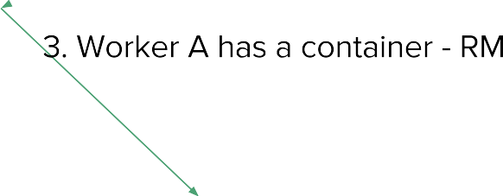
AM = Application Master NM = Node Manager
Worker A
NM A
AM 1
Resource Manager
Capacity Scheduler
Worker B
NM B
AM 2

Slide 39
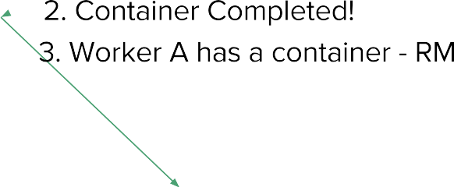
AM = Application Master NM = Node Manager
Worker A
NM A
AM 1
Resource Manager
Capacity Scheduler
Worker B
NM B
AM 2

Slide 40

AM = Application Master NM = Node Manager
Worker A
NM A
AM 1
Task
Resource Manager
Capacity Scheduler
Worker B
NM B
AM 2

Slide 41
AM = Application Master NM = Node Manager
Worker A
NM A
Task 1
AM 1
Resource Manager
Task 2
Capacity Scheduler
Worker B
NM B
AM 2

Slide 42
YARN (Yet Another Resource Negotiator)
Manage resources for processing tasks
each node in the cluster provides resources for executing tasks
Computing resource types:
CPU, Memory and Disks
also support GPU and FPGA Node
Computing resources are abstracted into “Containers”
don’t be confused: it is not a (Docker) container!
Multi-tenancy support

Slide 43

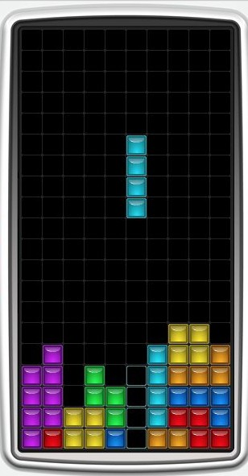
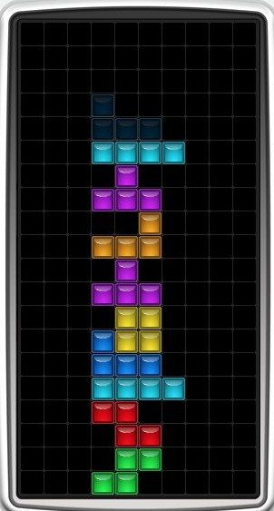

With a scheduler
Without a scheduler

Slide 45

RM = Resource Manager AM = Application Master NM = Node Manager

Slide 46
Worker A
Data Block 1
NM A
AM 1
MapReduce
YARN
MP2
HDFS
Worker B
Data Block 2
NM B
AM 2

Slide 47
Worker A
Data Block 1
NM A
AM 1
MapReduce
YARN // Resource Manager
MP2
HDFS // Name Node
Worker B
Data Block 2
NM B
AM 2

Slide 48
Task Worker C
Worker A
Data Block 1
NM C
NM A
AM 3
AM 1
MapReduce
Task Worker D
YARN // Resource Manager
NM D
AM 4
HDFS // Name Node
Worker B
Data Block 2
NM B
AM 2

Slide 49
Programming models
YARN is an execution environment
YARN allows different programming models for applications
MapReduce
Apache Spark
Workflows
E.g., Apache Tez for DAG (direct acyclic graph) of data processing tasks

Slide 50
Integration models
Using Hadoop for developing large-scale data analysis
Apache Spark, HBase, Hive, Apache Tez
Using Hadoop HDFS as components in a big data system
Hadoop HDFS can become data storage → storage layer
emerging data lake models, combined batch and stream ingestions for incremental data processing
e.g., Apache Hudi

Slide 51







ETL and Analytics with Hadoop/HDFS
Analysis
Data
Data
Application
Data
Source1
Source1
Database
Source n
result
Ingestion Engine
Analysis Engine
Analysis
HDFS
Data Ingestion:
Hadoop (and additional frameworks)
HDFS Client/Hadoop Streaming
Computing/Data Processing Framework
Apache Spark
HDFS as storage for databases
Accumulo, Druid, etc.
Spark Streaming
Kafka Connect
Apache Nifi
Hadoop MapReduce
Apache Tez

Slide 52
●
●
●
●

Slide 53

●
●
○
$ hadoop jar $STREAMING_JAR \
-files mapper.py,reducer.py
-mapper mapper.py -reducer reducer.py \
-input /shared/my_cool_dataset -output my_job_out

Slide 54
●
$ python my_mr_job.py -r hadoop
--output-dir my_job_out
--no-output
# HDFS directory
# Suppress output via STDOUT
hdfs:///data/my_cool_dataset # HDFS path for input

Slide 55

●
○
●
○
○
○

Slide 56
●
○
●
○
○
○
●
○
○
○

Slide 57
●
●
●
●

Slide 58
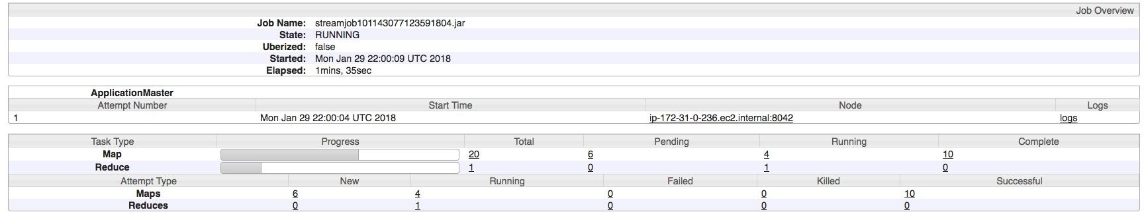

Slide 59
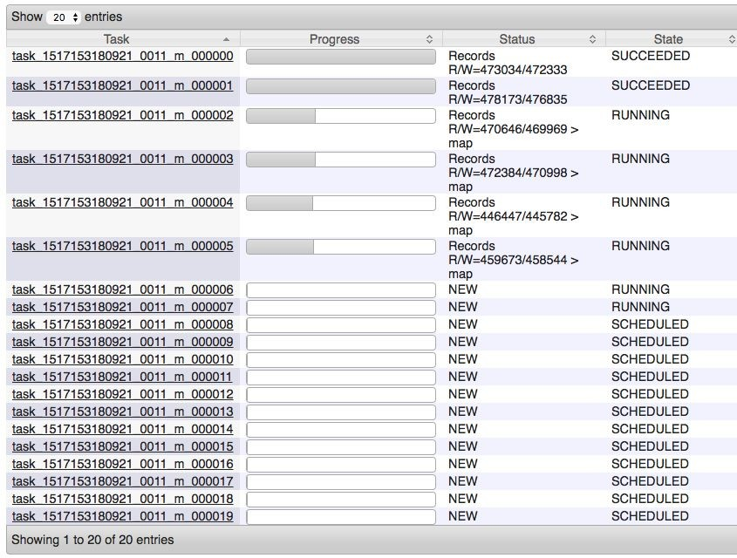

Slide 60
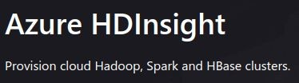
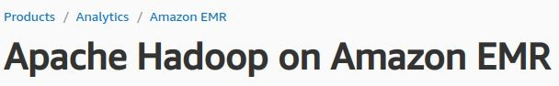

Is that Hadoop dead/unattractive?
Hadoop is for shared nothing architecture
Shared nothing architectures are not “modern”?
new, advanced developments w.r.t. memory, networks, …
in-memory processing, move data to computing nodes
Many tools seem not powerful for data science/ML?
Java vs Python development for data science and ML
services in ecosystem
near realtime analytics use cases
So why do we still study it?
foundational designs & still many Hadoop services are important (data warehouse, deep storage)
well-supported by many cloud providers for big data workloads
e.g.,

Slide 61
Why do we still need to learn Hadoop?
Hadoop file systems as a storage for many big data services
databases: Accumulo, Apache Druid
data warehouses/Data Lakes: Hive, Hudi
Support different models of access/analytics
via SQL styles atop big data platforms: You can do extract/transform/load (ETL), reporting, and data analysis using SQL styles
large-scale parallel programming (e.g., Spark)
Still many needs, given shared nothing architectures and on-premise conditions

Slide 62
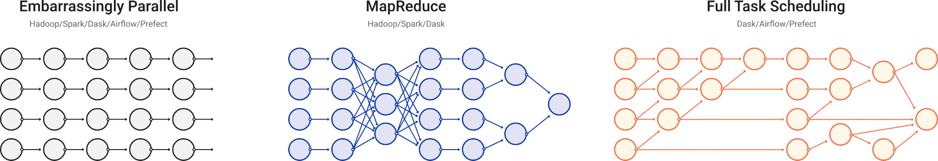

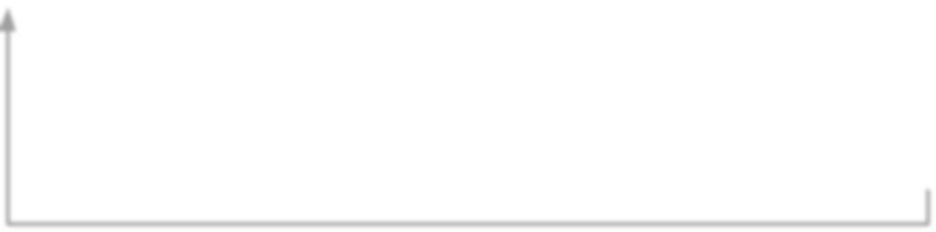

Why do we still need to learn
Hadoop?
Figure source: https://docs.dask.org/en/stable/graphs.html
needs for internal processing
SQL-style
Data parallelism
enables the implementation
Analytics/ ML
YARN Distributed executors
SQL-on-Hadoop
offers SQL features for analytics

Slide 63
Enabling analysis big data using SQL style
Provide command line tools & JDBC and server for integration
“SQL-on-Hadoop”
Examples
Apache Hive, https://hive.apache.org/
Data warehouse, access data in HDFS or Hbase
Apache Druid (using HDFS as a deep storage)
Spark SQL for various types of files

Slide 64







Integration with other cloud storage
services
Dremio | Spark | …
Driver/Connector
On-premise or cloud
Cloud
big datasets
Bucket |  | Bucket | Bucket
Node | Node |  |  | Node
Blob Storage & Data Lake in the Cloud

Slide 65
Hadoop-native big database/data warehouse systems
Notes:
https://cloud.google.com/bigtable/docs/hbase-differences

Slide 66

HBase
NoSQL database atop Hadoop
use HDFS for storing data
use YARN for running jobs on data
Follow a master-based architecture
Reading – Why HBase?
https://engineering.fb.com/2010/11/15/core-data/the-underlying-technology-of-messages/ https://engineering.fb.com/2014/06/05/core-data/hydrabase-the-evolution-of-hbase-facebook/ https://engineering.fb.com/2018/06/26/core-data/migrating-messenger-storage-to-optimize-performance/
Notes:
https://www.youtube.com/watch?v=cEjDR3B_3cs

Slide 67


Recall: Big data: column-family data model
Many situations we aggregate and scan few columns of million rows of data ⇒ store big data in columns enable fast scan/retrieval/aggregation
Column Family = (Column, Column, …):
for similar type of data & access patterns
Column Key =Family: qualifier
Data = (Key, Value) where Key =(Row Key, Column Key, Timestamp)

Slide 68






Example of a data model in HBase
Column
Column family (e.g., birdinfo)
Row key
Cell: versioning
species
birdinfo: country
birdinfo:eng lish_cname
duration
1
Aberti
US
…
3
2
species
birdinfo:c ountry
birdinfo:englis h_cname
duration
name
url
latitude
longitude
Text
Row
Sparsely stored: not all rows have the same number of columns

Slide 69
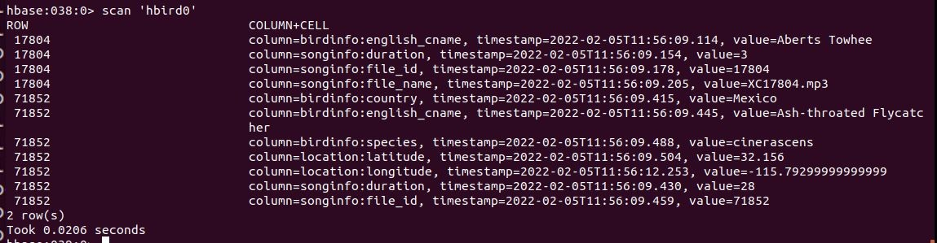
Example of a data model
Example with families: birdinfo, songinfo, location
Enable analytics based on column families (as well as data management)

Slide 70
HBase data model – sharding and storage
Table includes multiple Regions
a Region keeps related row data of a Table (partitioning)
Auto-sharding
Regions are spitted based on policies
Region has data of multiple column families
Different column families will be stored in different files
HFiles are used to store real data (also include index data)

Slide 71



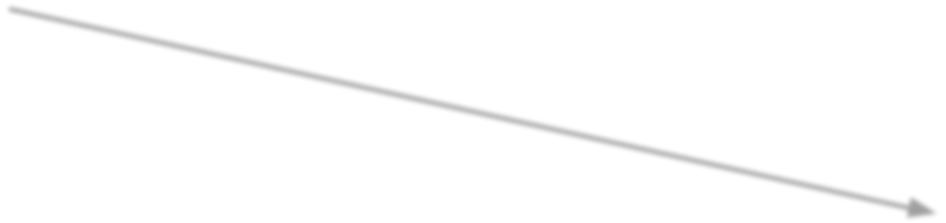
HBase architecture
Zookeeper:
shared state and failure notification of servers
master address and recovery
HMaster
Zookeeper
RegionalServer
RegionalServer RegionalServer
Data Node
Data Node
HDFS
Data Node

Slide 72


HBase architecture
RegionalServer
MemStore: write cache for data in memory before written into files
BlockCache
Region
Region
BlockCache: for read cache
Store
WAL (Write
MemStore
Ahead Log)
WAL is for durability
HFile
HFile

Slide 73
ACID
Atomic within a row
Consistency
can be programmed: e.g.,
read: STRONG (read performed by the primary region) and TIMELINE (primary region first, if not, then the secondary region)
Durability
can be programmed
○ WAL (write ahead log)

Slide 74
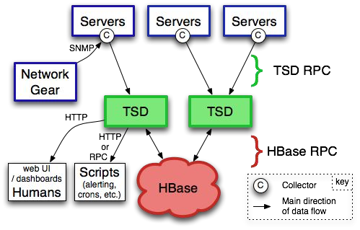
Example of using HBase
Open Scalable Open Time Series Database (OpenTSDB)
Salesforce
Salesforce Shield: for supporting data security/compliance
Field Audit Trail: for track changes
Event Monitoring: log/event
Argus: time series data and
alerts
Source:
https://engineering.salesforce.com/investing-in-big-data-apache-hbase-4 20edfba2d30/
Figure source: http://opentsdb.net/overview.html

Slide 75
Apache Hive

Slide 76
Apache Hive
https://hive.apache.org/, on top of Hadoop
data warehouse at a very large-scale
access data in large-scale storage like HDFS or S3
Support access to data via SQL styles
extract/transform/load (ETL), reporting, and data analysis using SQL styles
Provide command line tools & JDBC and server for integration
Reading – Hive in Facebook
https://engineering.fb.com/2009/06/10/web/hive-a-petabyte-scale-data-warehouse-using-hadoop/

Slide 77
High-level data flow language & programs
MegaStore
SQL-alike
Hive Shell
Hive Shell and Execution Engine
Hive script (HiveQL)
Schema
Distributed Task Execution Engine
HDFS | Amazon S3
 | Other storages
Hadoop

Slide 78



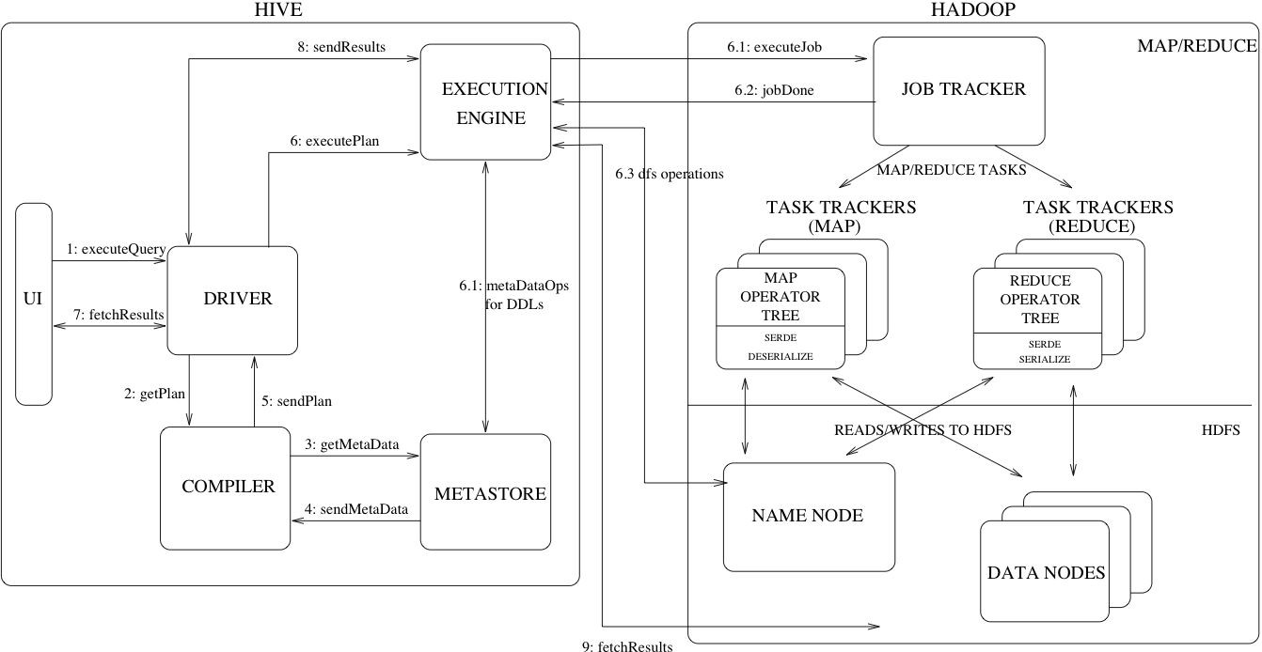
Hive building blocks
Distributed tasks with MapReduce
,
Tez (Workflow) or
Spark
Figure source: https://cwiki.apache.org/confluence/display/Hive/Design

Slide 79
Hive data organization
Schema-on-read approach
schema inferred from data, structured and unstructured data
Databases
Table
Managed table versus External tables
External table: real data is stored outside Hive and referenced so delete only table metadata but not the data (read data only)
Table is mapped to a directory in HDFS
Low-level files: CSV, Apache Parquet,ORC, …
Managed vs External tables concept:
also in BigQuery, Snowflake, Databricks Lakehouse

Slide 80
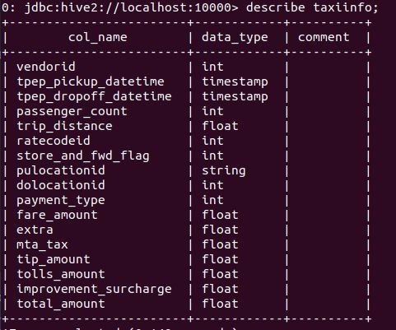
Example
Large tables lead to performance issues

Slide 81
Hive data organization for performance optimization
Partitioning: using value of a column as a partitioning key
partition keys determine how data in Table will be divided
E.g. date or countries
each partition is stored as a subdirectory
Avoid many sub directories!
Buckets: using a hash function of a column for grouping records into the same bucket
avoid large number of small partitions
each bucket is stored in a file
bucket columns should be optimized for join/filter operations

Slide 82





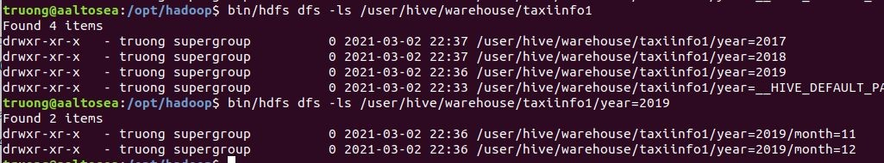
Example of partitions
CREATE TABLE taxiinfo1 ( ….) PARTITIONED BY (year int, month int)
…;
Indicate partition info
Define partition names
LOAD DATA LOCAL INPATH …… INTO TABLE taxiinfo1 PARTITION (year=2019, month=11);

Slide 83




Example of buckets
CREATE TABLE taxiinfo2 (VendorID int, ….) CLUSTERED BY (VendorID) INTO 2 BUCKETS
……;
Identify bucket column
Combine partitions with buckets

Slide 84
ACID
ACID support
for managed tables
different for CRUD and insert-only tables
Locks are used for data isolation
shared lock: for concurrent read of tables/partitions
exclusive lock: for modifying table/partition

Slide 85
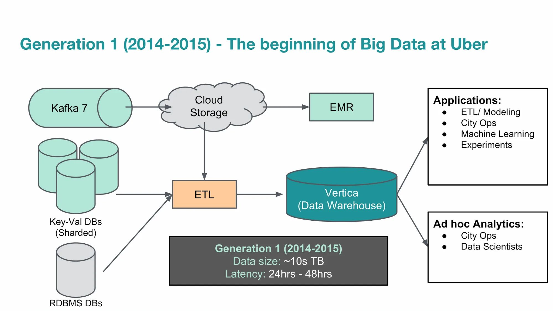
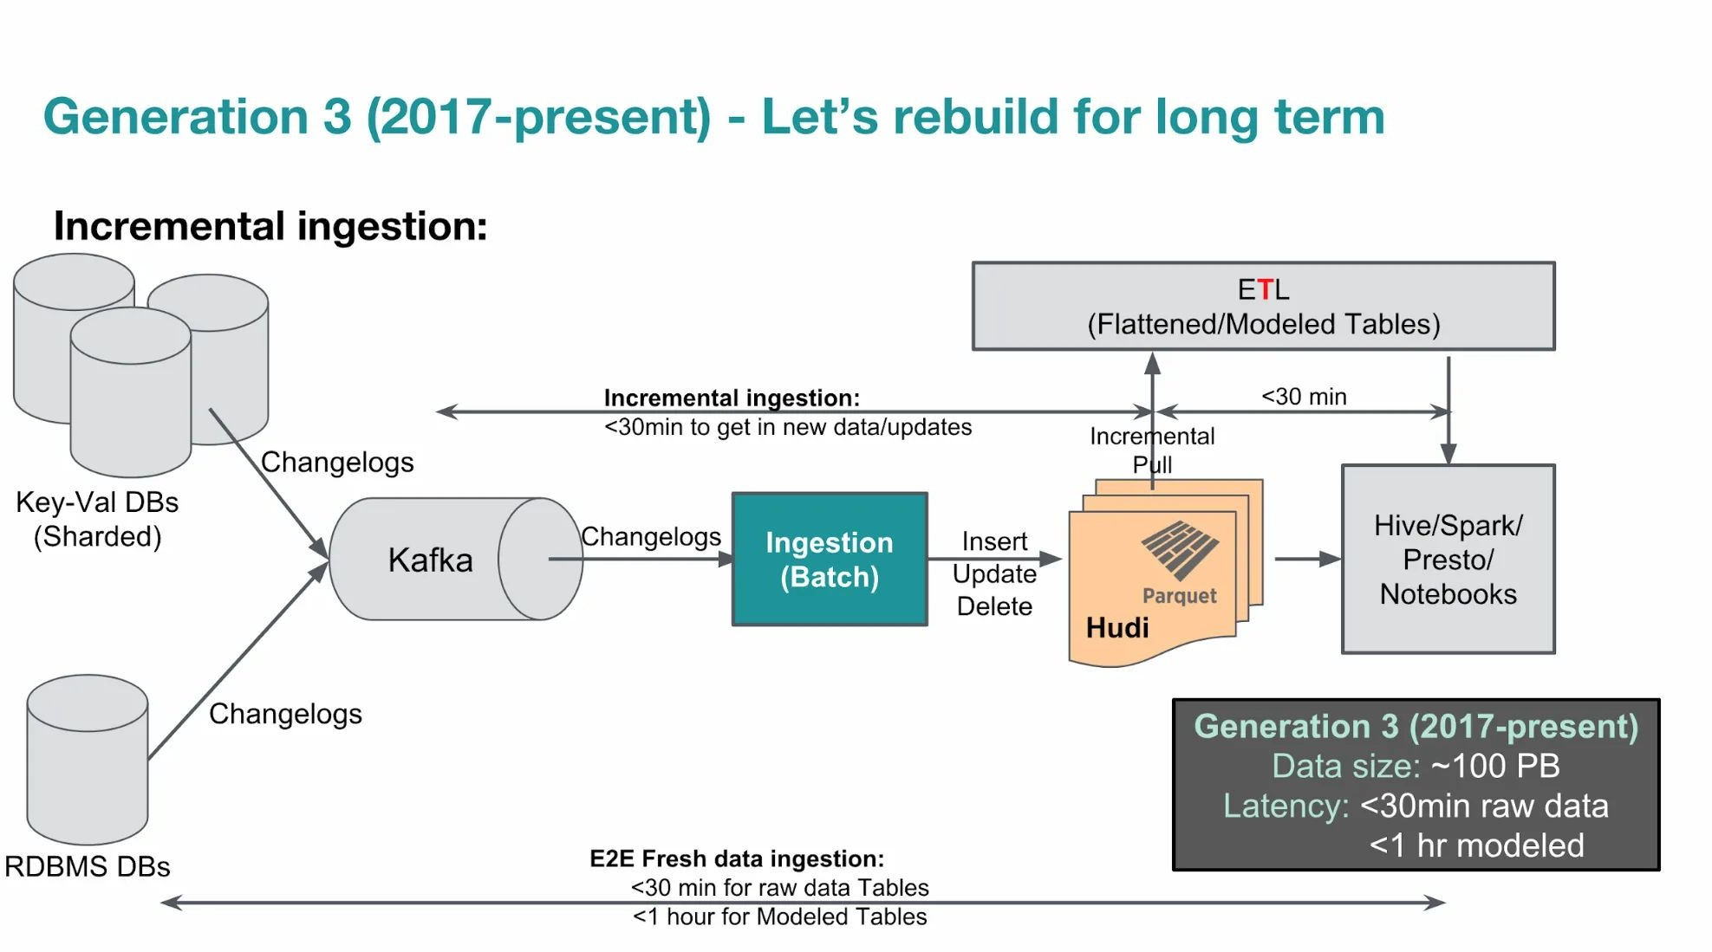
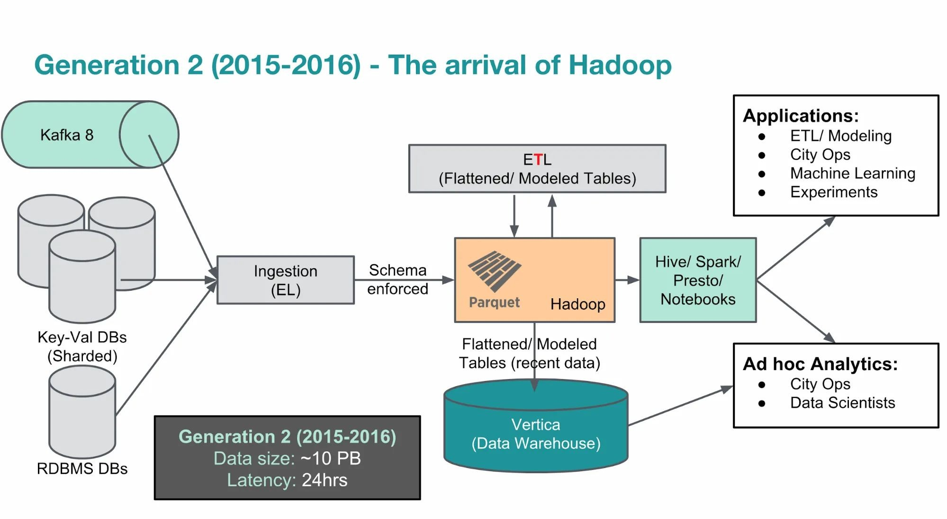
Uber example
Hive for analytics: “extremely large queries”, “ “20,000 Hive queries per
day” (see the source)
Figures source:
https://www.uber.com/en-FI/blog/uber-big-data- platform/

Slide 86
Hive in the age of ML
Hive has been around for a while → many goals have been diminished
But Hive Megastore continues an important role in data lakes and distributed data querying
power data management and discovery
support unified data management
enable “feature store”, discovery features used for machine learning

Slide 87
Summary
Hadoop software ecosystem is very powerful
many applications and use cases have been developed
Hadoop File System (HDFS) is a crucial subject
Managed Hadoop ecosystem services by cloud providers
try to look at Azure HDInsight, Google Dataproc, and Amazon EMR
High-level distributed query engineering using Hadoop components (HDFS, Hive)
Understand the combination of data management with data processing techniques in the same system
with Hadoop that simplify your big data tasks

